Slide 1


HOME
TEAM
PROBLEMS
END
GROUP PROJECT
presented by team E

Slide 2



HOME
TEAM
PROBLEMS
END
﻿meet the team
Hamdi Emad
Mariem Adel
Esraa Saed
Abdelrahman Mohamed
Ahmed Ayman
Sara Hussien
Ahmed Shehata
Muhamed aly

Slide 3
HOME
TEAM
PROBLEMS
END
importANCE OF BASH SCRIPTING
1
2
Task Automation & Time-Saving
System Efficiency Improvement
3
4
Security & Backup Management
Continuous Monitoring & Analysis

Slide 4

HOME
TEAM
PROBLEMS
END
Content of problems
System Health Check Up
Automated Backup and Recovery Tool

Slide 5
INTRODUCTION
SCRIPT
VIDEO
The problem performs the following tasks:
- CPU Usage Monitoring : Checks system load and CPU utilization.
- Memory Usage Monitoring : Reports available and used memory.
- Disk Usage Monitoring : Ensures sufficient free disk space is available.
- Network Connectivity Check : Verifies active network connections and internet status.
- Pending Software Updates Check : Lists updates that need to be installed.
- Log File Generation : Creates a timestamped report for future reference.
- Email Notifications : Sends system reports to a predefined email address.

Slide 6
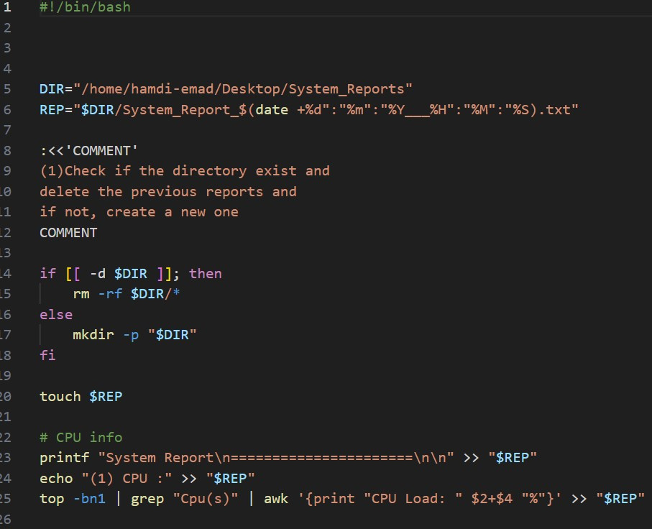
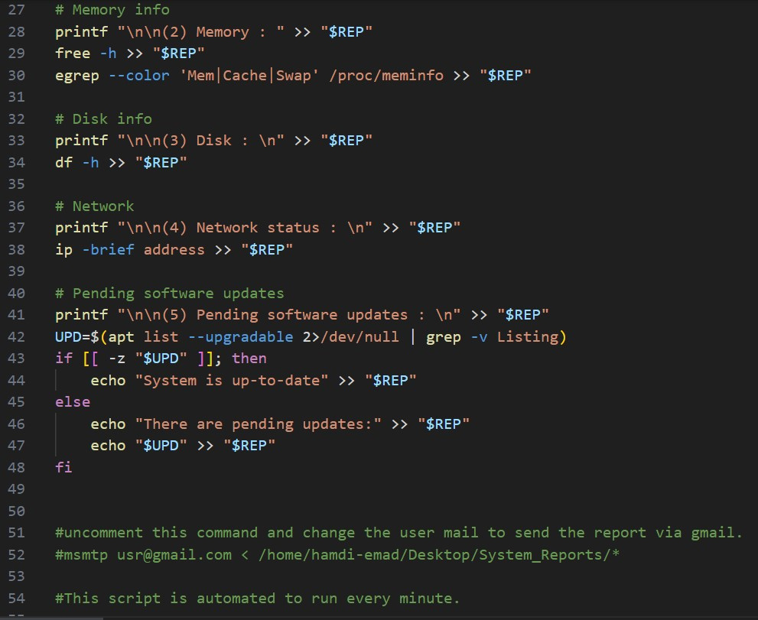

INTRODUCTION
SCRIPT
VIDEO
script

Slide 7
Guess 🫵 where is the duck🦆

Slide 8
INTRODUCTION
SCRIPT
VIDEO
(1). CPU
lscpu : The lscpu command provides detailed information about the CPU architecture and characteristics.
cat /proc/cpuinfo : file contains information about the CPU and its features.
top & htop : The top and htop commands are system monitoring tools that provide real-time information about processes and system resources.
nproc : The nproc command displays the number of processing units available.
(2). Memory
free : Total amount of free and used physical memory.
free -m : for information and usage in MB.
free -g : for information and usage in GB.
free -t : This will simply total the amount of
memory in columns.
vmstat : reports virtual memory statistics.
(3). Disk
df : shows available and used disk space on the Linux system.
df -h : shows disk space in human-readable format.
df -a : shows the file system's complete disk usage even if the Available field is 0.
du : shows the disk usage of files, folders, etc. in the default kilobyte size.
du -h : shows disk usage in human-readable format for all directories and subdirectories.
du -a : shows disk usage for all files.
du -s : provides total disk space used by a particular file or directory.
(4). Network status
ip a : Displays all network interfaces and IP addresses.
ifconfig : configure a network interface (-a, -s, -v).
ip r : Show the current routing table.
sudo ufw status : check firewall status.

Slide 9
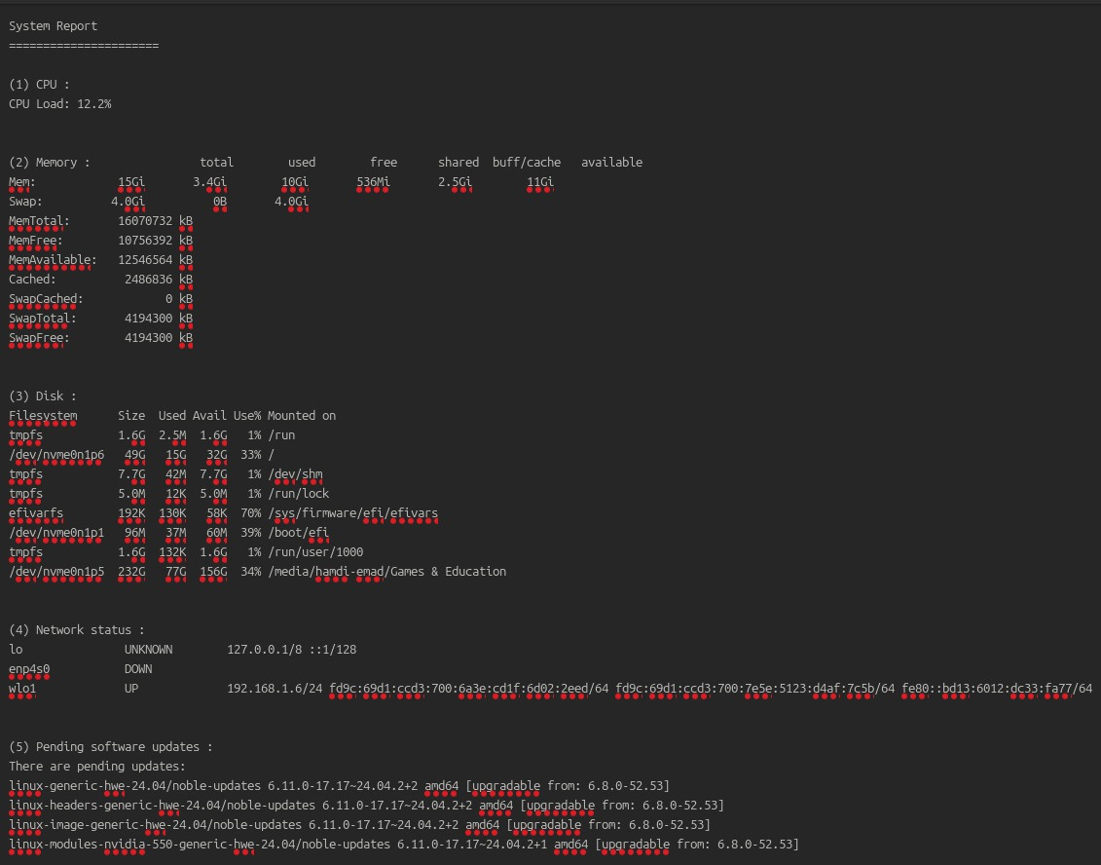
INTRODUCTION
SCRIPT
VIDEO
CPU :-
top -bn1 | grep "Cpu(s)" | awk '{print "CPU Load: " $2+$4 "%"}' >> "$REP" :
top -bn1 : to run the command in batch mode and only once, which can display the information without the interface.
grep "Cpu(s)" : to search in the output for this word and display it without the other results.
awk '{print "CPU Load: " $2+$4 "%"}' : used to add the (us) and (sy) resulted from the previous command ($2 refers to "us" and $4 to "sy").Together, it represent the total CPU load.

Slide 10
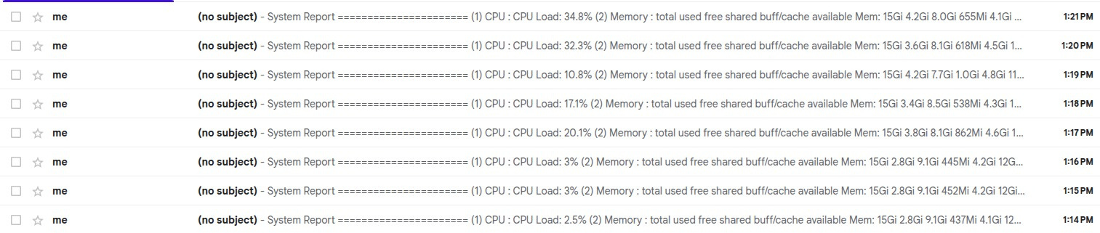
INTRODUCTION
SCRIPT
VIDEO
to send the text file to the user email : msmtp usermail@example.com < file.txt
for make this script automated, we entered crontab -e command.
crontab refers to cron table which is a time-based scheduler to automate the scripts.
* * * * * : represents the minute, hour, day of the month, month and day of the week.
if you want to automate the script to run every day in 5 AM, just make the first * to be 0 and the second one to be 5.
if you want to make it every period of time, make it like this */number.

Slide 11

INTRODUCTION
SCRIPT
VIDEO

Slide 12
HOME
TEAM
PROBLEMS
END
Content of problems
System Health Check Up
Automated Backup and Recovery Tool

Slide 13
INTRODUCTION
SCRIPT
VIDEO
The problem performs the following tasks:
- Customizable Backup Location : Users can choose which directories to back up.
- Automated Backup Scheduling : Runs backups at regular intervals .
- Compressed Archives : Saves storage space.
- Backup Retention Management : Automatically deletes older backups.
- Restore Functionality : Allows restoring previous versions of files.
- Cloud Storage Integration : Syncs backups with Google Drive.

Slide 14
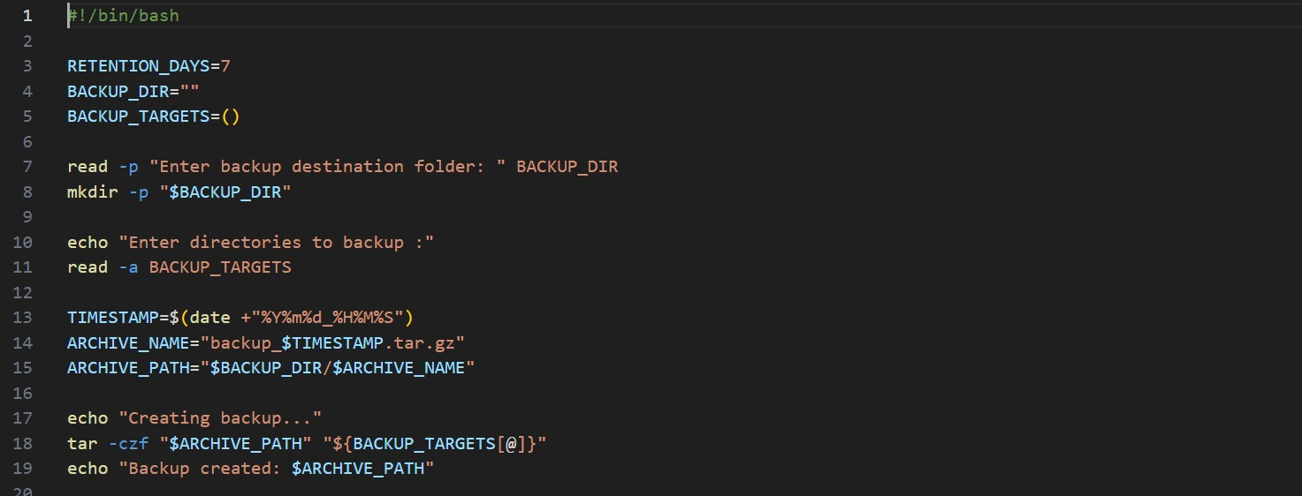
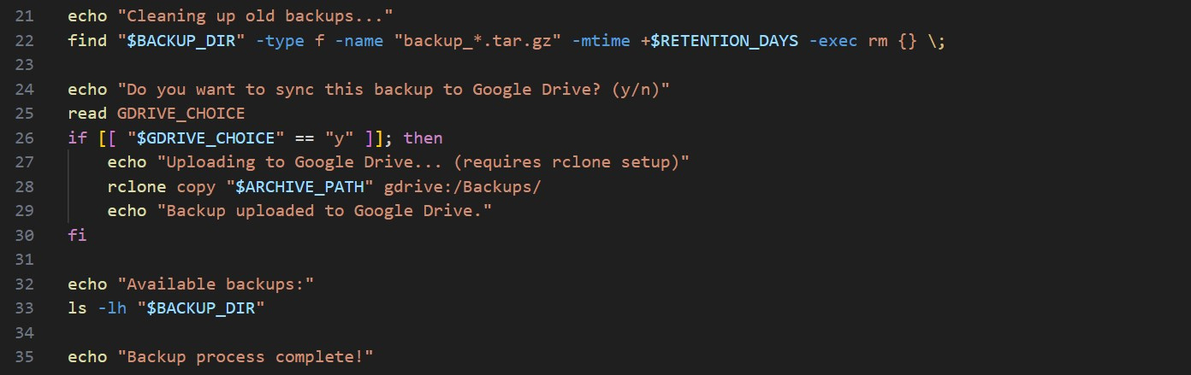
script
INTRODUCTION
SCRIPT
VIDEO

Slide 15
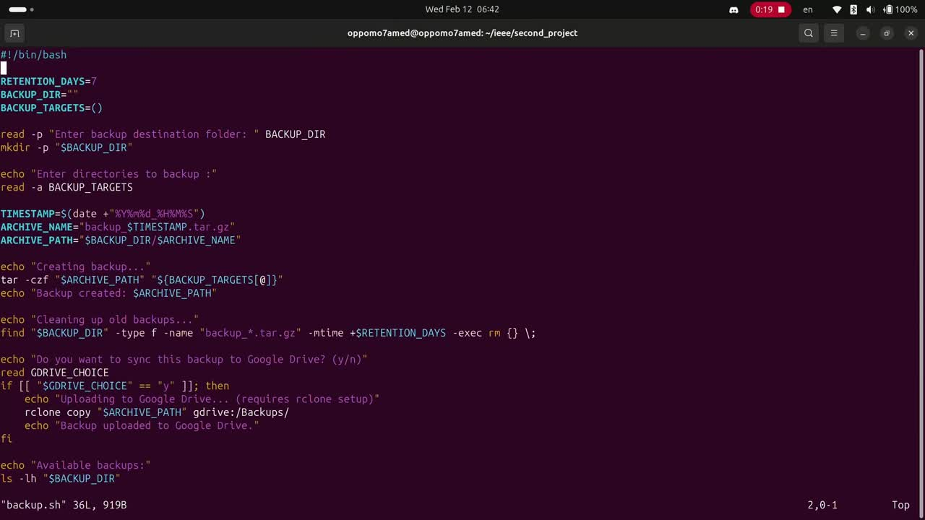
INTRODUCTION
SCRIPT
VIDEO

Slide 16
HOME
TEAM
PROBLEMS
END
THANK YOU

